Slide 1


Big Data & HPCC Systems
HPCC-Systems Solution Labs
2022

Slide 2
INTRODUCTION

Slide 3

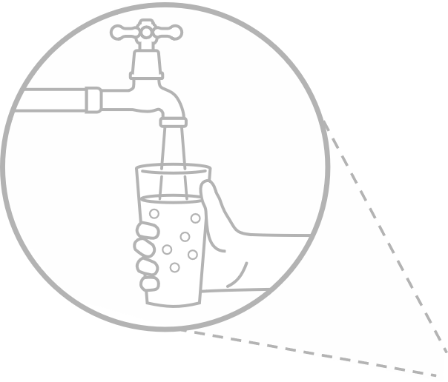





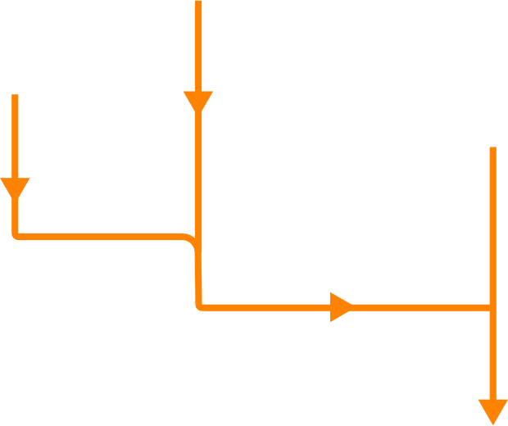

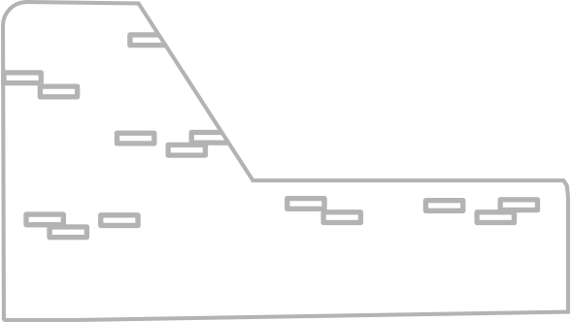
Key aspects of our data lake solution
The HPCC Systems advantage
1. Multiple types of raw data
Open source data lake platform
Batch, real-time and streaming data ingestion
Built-in data enhancement and Machine Learning APIs
Scalable to many petabytes of data
Runs on commodity hardware and in the cloud
Increased responsiveness to customers and stakeholders
5. Information Delivery
2. Batch, real-time and streaming ingestion
4. Data wrangling and machine learning
3. Open source data lake

Slide 4
Big Data Life Cycle
Collection: Collecting data in structured, unstructured format
Ingestion: Extracting, transform, loading, data to cluster
Discovery: Getting to know data, cleaning and shaping it
Integration: Linking, indexing, data fusion
Analysis: Machine learning, analytics and statics, visualization
Delivery: Query, summery, result, and availability

Slide 5
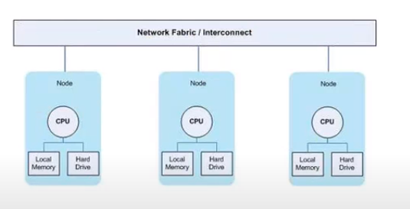
HPCC Systems Infrastructure
Complete data lake management platform
From a personal computer to hundred nodes to cloud
Commodity Cluster: Multiple independent processing nodes.
Commercial off-the-shelf components(COTS)
ECL (Enterprise Control Lang)
Supports different data types: xml, json, csv, flat, etc
Clusters
Thor
Roxie
Servers
Dali
Sasha

Slide 6
HPCC Platform Supports
High performance data delivery through web services, API and SQL
Easy integration with end user BI tools and workflows
Built-in plugins to support other languages such as Python, SQL, C++
Machine Learning library
Deep Learning built on top of TenserFLow
Built-in Data Profiling tool

Slide 7
Thor
Analytics
Profiling
Transform
Thor cluster
Data Refinery
Engine
Manage data more quickly and efficiently
Cleaning

Slide 8
ROXIE
Perform real-time queries with highly concurrent delivery
ROXIE cluster
Data Delivery Engine
Interfaces
JSON
XML
REST
SQL

Slide 9
ECL Watch

Slide 10
ECL Watch
Browser-based interface that provides admin control over a cluster
Monitor cluster status
Job information
View Data Profile
Schedule and reschedule periodic tasks
Manage data
Maintain Roxie queries
Security management
Default URL
http://hostname:8010

Slide 11
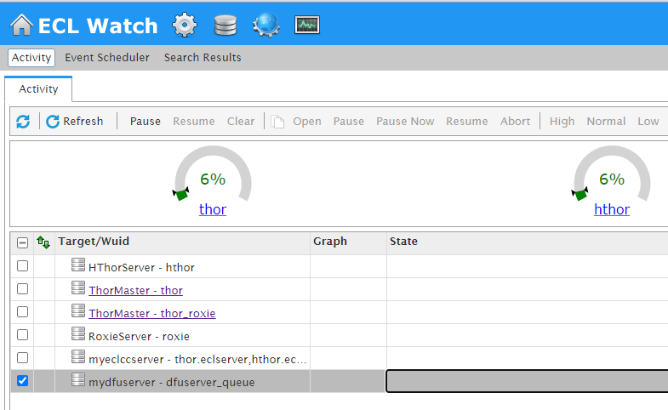
View Workunits
View Files
Published Queries
Cluster Information
Clusters Usage
Clusters Name

Slide 12
ECL & Big Data

Slide 13
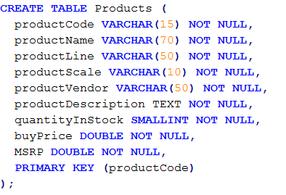
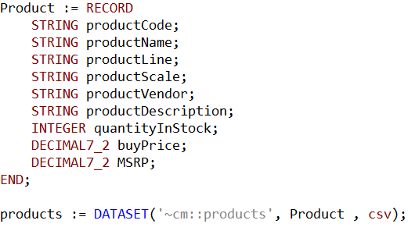
SQL vs. ECL (table and dataset)
SQL
ECL

Slide 14
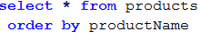
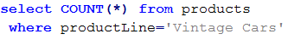
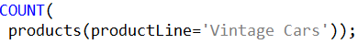
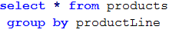
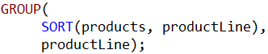
SQL vs. ECL (sort, count, group)

Slide 15
ECL
Source
ECL is a language design to query/manipulate massive data and is used for ETL (Extract, Transform, Load) and data visualization.
Extract
Reading data from different type of datasets
Transform
Formatting/converting data to needed shape, so it can be used
Load
Writing dataset to it’s target location
Extract
Transfer
Load
Destination

Slide 16
House Keeping
Declarative Lang
Not case-sensitive
White space is ignored
Formatting is recommended
// This is a single line comment
/* A block comment */
Object.Property syntax is used to qualify definition scope and disambiguate field references within datasets:
ModuleName.Definition //reference a definition from another module/folder
Dataset.Field //reference a field in a dataset or record set

Slide 17
House Keeping Cont
Definition assignment is :=
Semicolon terminator: num := 12;
Equality test is = valOne = valTwo
Attributes can be defined only once
Only those definitions that contribute to a result are actually compiled and used
There are no loops. TRANSFORM and PROJECT is used instead.

Slide 18
Common Data Types
Character
STRING[n]
UTF8
UNICODE[_locale][n]
Other
BOOLEAN
SET OF <type>
RECORD
DATASET
Numeric
INTEGER[n]
UNSIGNED[n]
REAL[n]
DECIMAL<n>[_y]
UDECIMAL<n>[_y]

Slide 19
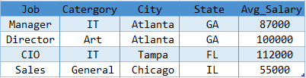
Record Structure
Defines the layout of fields in the dataset, order of the fields should be the same as the dataset.
Dataset
A physical data file. It can be defined in code (inline), or can be read from disk.

Slide 20
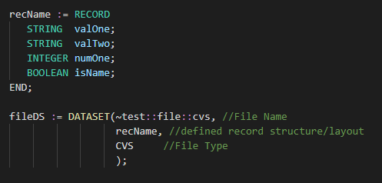
Import Dataset
FLAT Native file type for Thor; also used for fixed-length raw records
CSV Any kind of delimited data, including CSV-encoded data
JSON Data stored as a series of JSON objects
XML Data stored as a series of XML documents
PIPE Data obtained dynamically via process calls

Slide 21
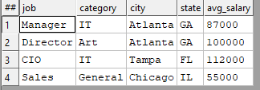
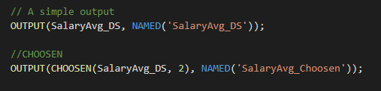
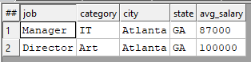
OUTPUT
Lets display result.
CHOOSEN
Returns the first n number of records.

Slide 22
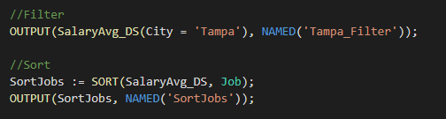
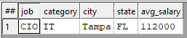
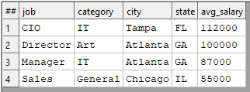
SORT
Ascending or descending sort
FILTER
Choosing a smaller part of dataset

Slide 23
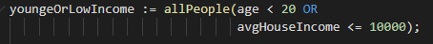
FILTER
All records within dataset will be evaluated
If boolean_expression evaluates to TRUE for a particular record, it will be included in the result
Logical Operators
AND
OR
NOT or ~
Comparison Operators
=
<> or !=
<
>
<=
>=
<=>

Slide 24
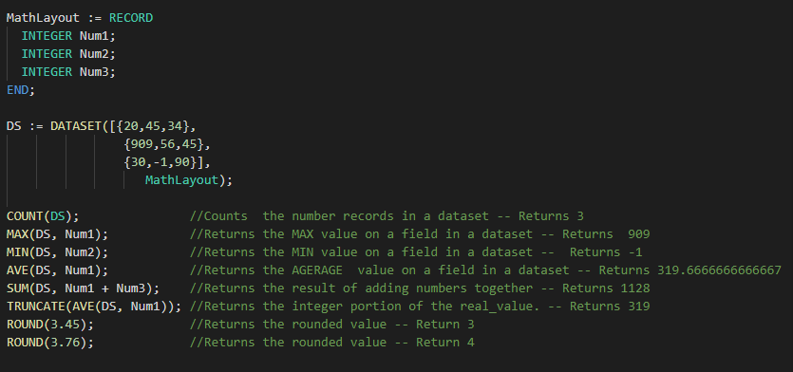
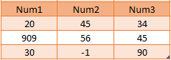
Math Functions

Slide 25
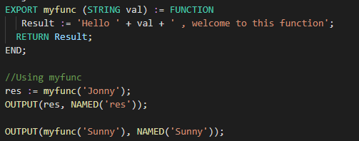
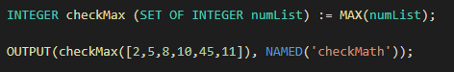
FUNCTION
One Line Function

Slide 26
MODULE
Is a container that allows you to group related definitions. The parameters passed to the module are shared by all the related members definitions.
Variable Scope
Local definitions are visible only up to an EXPORT or SHARED
SHARED definitions are visible within module.
EXPORT definitions are visible within and outside of a module .

Slide 27
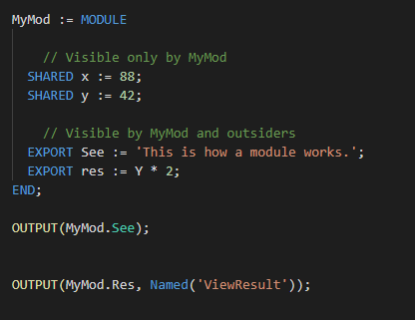
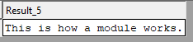
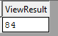

Slide 28
TRANSFORM
Specifies exactly how each field in the output record set is to receive its value.
It should include the result type.
Should contain name
Contains parameter list
SELF: refers to fields in result type.
PROJECT
Processes through all the records in the dataset performing TRANSFORM.
LEFT: refers to dataset getting passed to PROJECT.

Slide 29
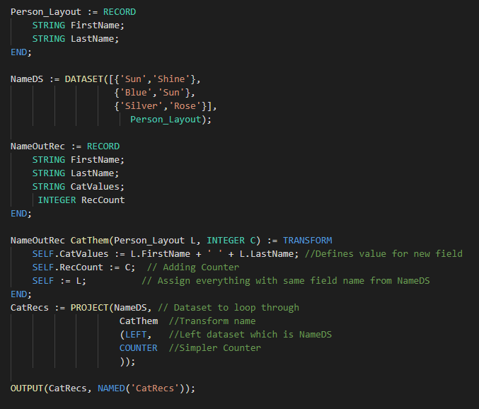
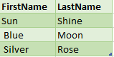
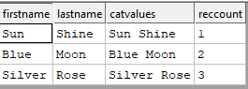
TRANSFORM
NameOutRec: Result Layout
CatThem: Transform Name
Person_Layout: Input Dataset Layout
L : Reference to Person_Layout fields
SELF: Refers to fields in result dataset
C: Will do the Counting

Slide 30
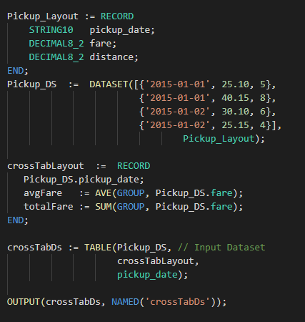
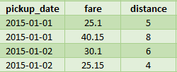
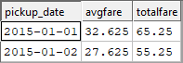
TABLE
Creates a temporary dataset in memory, GROUP option can be used.

Slide 31
JOIN
The JOIN function produces a result set based on the intersection of two or more datasets or indexes.
INNER: Only those records that exist in both datasets.
LEFT OUTER: At least one record for every record in the left.
RIGHT OUTER: At least one record for every record in the right.
LEFT ONLY: One record for each left record with no match in the left.
RIGHT ONLY: One record for each left record with no match in the right.
FULL ONLY: One record for each left and right record with no match in the opposite.

Slide 32
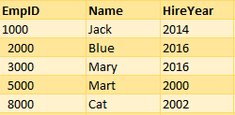
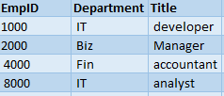
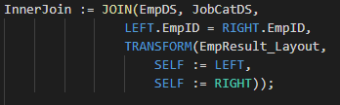
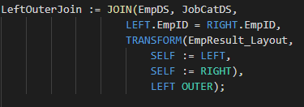
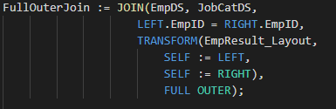
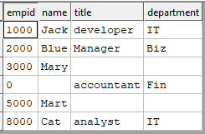
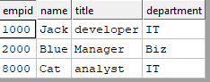
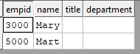
EmpDS
JobCatDS

Slide 33
REFRENCES
Learn ECL Academy
https://hpccsystems-solutions-lab.github.io
ECL training containing six short videos
https://www.youtube.com/watch?time_continue=192&v=Lk78BCCtM-0
ECL document
http://cdn.hpccsystems.com/releases/CE-Candidate-7.0.24/docs/EN_US/ECLLanguageReference_EN_US-7.0.24-1.pdf
Standard Library
https://cdn.hpccsystems.com/releases/CE-Candidate-7.10.16/docs/EN_US/ECLStandardLibraryReference_EN_US-7.10.16-1.pdf

Slide 34


